Slide 1
Ontology Driven Extraction of Research Processes
By-
Aayoush Aayoush
Mamta Pednekar
Sushma Kallapur

Slide 2
About the Paper
Title: ONTOLOGY DRIVEN EXTRACTION OF RESEARCH PROCESSES, The International Semantic Web Conference (ISWC), 17th International Semantic Web Conference, Monterey, CA, USA, October 8–12, 2018, Proceedings, Part I.
Year of Publication: 2018.
Track: Research.
Authors: Vayianos Pertsas, Panos Constantopoulos, Ion Androutsopoulos.
Affiliations: Department of Informatics, Athens University of Economics and Business 2 Digital Curation Unit, IMSI - Athena Research Centre.

Slide 3
Approaching the literature review process
Paper selection process:
Referred different papers from ISWC Website from the last five years.
Shortlisted and ensured that the resource is accessible.
Analyzed the paper and identified the problem statement, solutions and its findings.
Identified accurate usage of academic language and writing conventions appropriate for the presentation.
Challenges Experienced :
Selecting from a wide variety of topics.
Accessibility of research papers were limited.
Since the paper belongs to research track, there were not many in-use resources available, hence making it challenging to visualize.
Noticed few minor grammatical errors.

Slide 4

Research Problem
Increase of scientific publications in every discipline makes it difficult to maintain overview of domain, new work or reinvent solutions and makes it harder to relate ideas from different domains.
Understanding and encoding knowledge contained in research articles is a complex task which poses several challenges.
This paper addresses the problem of automatically extracting from publications.

Slide 5
The Conventional Way
Named Entity Recognition
Relation Extraction
Article Metadata

Slide 6
Disadvantages of the Conventional way
Research activities have variable length and often span multiple sentences, unlike simpler relation extraction tasks.
They follow specific pre-defined nomenclature.
Focuses on smaller portion of the sentence.
Sequence relations between activities cannot be detected solely through lexical cues.

Slide 7
The Proposed Solution
Embeddings
Word
Part of Speech
Dependency
Sliding Window to explore extraction tasks across dimensions
Process Granularity
Feature Space
Machine Learning Method

Slide 8
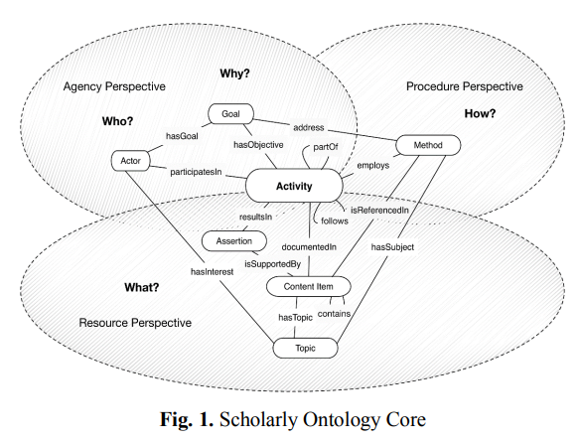
Conceptual Framework: the Scholarly Ontology
The rationale behind the ontology is to support documenting “who does what, when, and how” in a given scholarly domain.
Central notion of activity and combines three perspectives
The agency perspective
Procedure perspective
Resource perspective
We focus on extracting two key concepts of the ontology
Activity and Binary Predicate

Slide 9

The Dataset and Techniques
Unlabeled dataset obtained from 50,000 open-access research papers was used in order to create embeddings.
10,000,000 sentences after metadata cleaning and parsing using spaCy.
100,000,000 tokens and eventually a vocabulary of approx. 1,000,000 unique words (types). Word, part-of-speech tag (POS) and dependency (DEP) embeddings were generated.
Specifically, 100-dimensional word embeddings were produced using the Gensim implementation of word2vec.

Slide 10

The Dataset and Techniques (contd.)
The training set, comprising texts from 50 research articles covering 9 research domains.
The annotation of the training set yielded approx. 1,000 sequence relations and 1,700 activities comprising approx. 31,000 tokens. For hyper-parameter tuning, 3-fold cross-validation was used.
For testing, the articles from three disciplines, Digital Humanities (DH), Bioinformatics (BIOINF) and Medicine (MED) were used.
Experiments with other general-purpose, publicly available embeddings, such as those trained on the Common Crawl corpus using GloVe9 showed inferior performance compared to this domain-specific embeddings.
The research articles were randomly selected using APIs from publishers, scraping online journals such as the Digital Humanities.

Slide 11

Extracting Research Activities
Seven sliding window classifiers (SWC) and a two-stage pipeline classifier were implemented for extracting research activities.
The size of the window was set at 30 tokens.
Hyper-parameter tuning and Zero-padding was used to represent tokens exceeding the sentence boundary.
M.E.F.F to denote the resulting classifiers, where M denotes the learning method used, E the embeddings and F the special features.
The first and second classifiers, LR.WP.B and SVM.WP.B.
The third and fourth classifiers, LR.WPD.BS and SVM.WPD.BS.
The fifth classifier, RF.PD.BS, employs Random Forests (RF) and uses 51 one-hot features representing POS tags and 71 one-hot features representing DEP tags (PD), rather than embeddings.
Fig. 2.Activity Extraction Pipeline

Slide 12
Extracting Research Activities (Contd.)
The sixth and seventh classifiers, LR.PD.S.BS and SVM.PD.S.BS, are like the third and fourth with the difference that: (a) they omit features related to word embeddings, and (b) they account for the syntactic sequence (S) of words.
The intuition behind the pipeline is that, by splitting the task into two simpler sub-tasks, each separate classifier will achieve high enough accuracy.
Text chunk bounded by these two entities, [act1,…, act2], is treated as expressing a candidate sequence relation(A maximum chunk length of 500 tokens).
Each chunk is represented using averaged word/POS/DEP embeddings of the tokens.

Slide 13
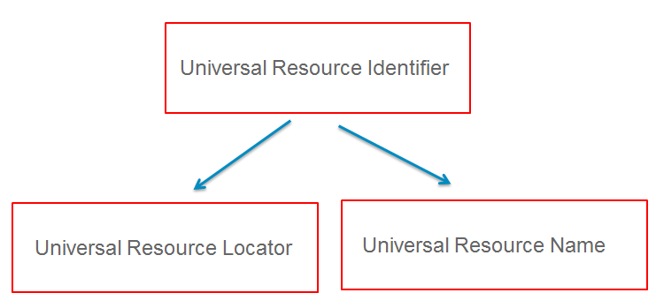
Background Context Integration and URI creation
Process knowledge base is created by encoding the extracted information as RDF triples adhering to Linked Data principles and the RDFS10 and NIF11 models.
Having extracted research activities and their sequence relations, we attach to them contextual information obtained from the metadata of the publications.
Entities with a proper name such as Persons, Organizations, Articles and Topics, their URIs are derived by combining the namespace of the knowledge base, the entity type according to SO, and a unique id provided by the entity name.
Activities and sequence relations, URIs are generated by combining the namespace of the knowledge base, the entity type according to SO, the source of extraction (publication id) and the two offsets identifying the boundaries .
Fig. 3.URI

Slide 14
Evaluation
The performance of all the classifiers were evaluated by measuring Precision, Recall and F1 scores for the Information extracted from text.
Classifiers were trained on the entire training set (DH, BIOINF and MED).
Approximate Randomization Tests (ART) were carried out between every classifier and the relevant baseline, to ensure the statistical significance of the tests.
As more than 2 systems were compared, the Bonferroni correction was used to adjust the threshold (p-value).

Slide 15
Research Activity Extraction Evaluation
The evaluation of activity extraction methods involved comparing classifier results against a reference standard, produced by human annotators.
The classifiers were compared with a ‘baseline’ method (which is similar to NER Tasks).
Two groups of comparisons are made: a) token-based b) entity-based.
Token Based Evaluation and Entity Based Evaluation
Token Based Evaluation | Entity Based Evaluation
True positive: Token is correctly classified as part of research activity. False positive: Token is incorrectly classified as part of research activity. False negative: token incorrectly classified as non-part of a research activity. | True positive: string that matches a reference standard string by at least 86%. False positive: un-matched predicted string. False negative: un-matched reference standard string.
Baseline performed worse than all the other classifiers on every test set and criterion. | The baseline again performs worse than all other methods.

Slide 16
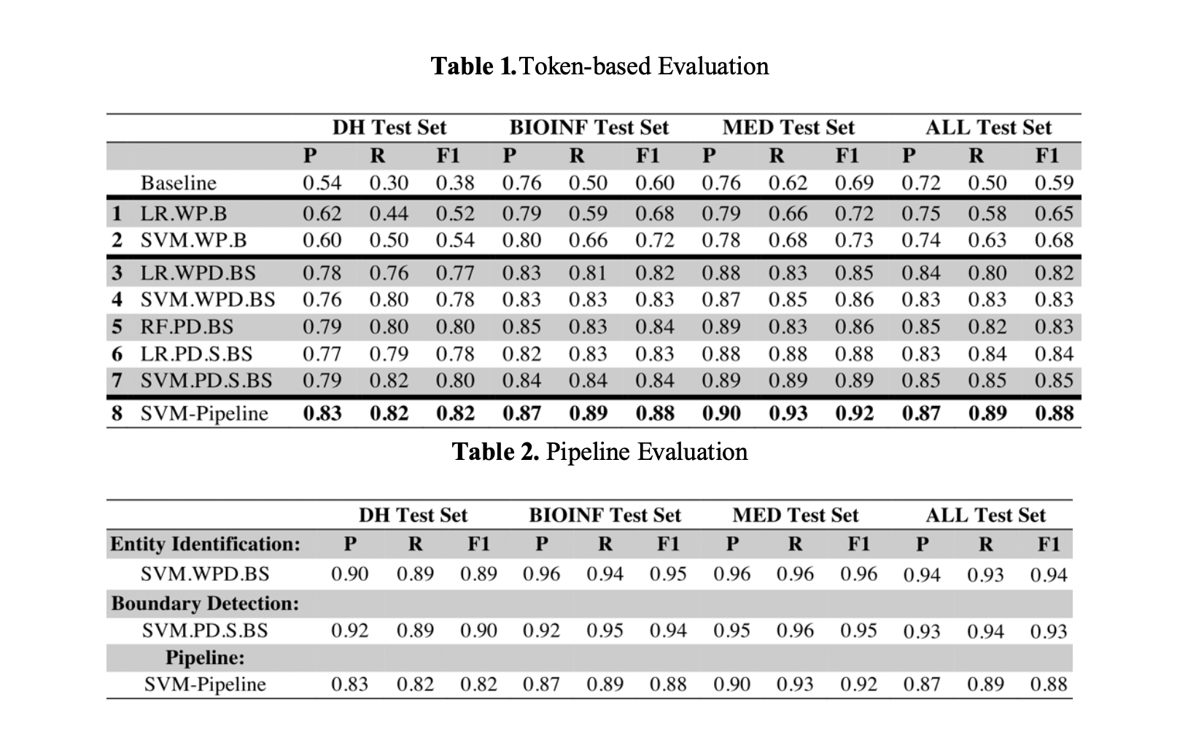
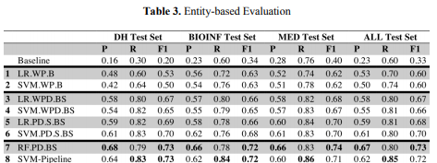
The performance decrease in entity evaluation was found to vary among domains:
6.9% average decrease in F1 scores was observed with the DH test set.
The decrease was 14.5% with the BIOINF test set.
15.9% with MED.

Slide 17
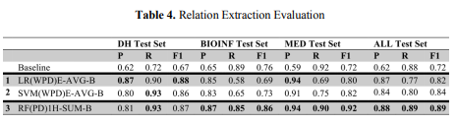
Sequence Relation Extraction Evaluation
The evaluation of sequence relation extraction methods involves comparing the predicted relations among the reference standard entities in each test set with those produced by the human annotators on the basis of Precision, Recall and F1 scores.
Classified as:
True Positive: classifier correctly predicted the follows (act2, act1) property.
False Positive: chunk for which follows (act2, act1) was incorrectly predicted.
False Negative: chunk for which follows (act2, act1) incorrectly failed to predict.
Classifier performance is also compared with a simple baseline method
In sequence relation extraction, RF.PD.B performed best in BIOINF, MED and overall (F1: 0.86, 0.92 and 0.89 respectively), while for the DH test set the forerunner was LR.WPD.B (F1: 0.88).

Slide 18
Conclusion
Addressed the automatic extraction from the text of publications.
Complexity of the task demands more complex feature engineering than usual NER tasks.
Implemented and tested several sliding window classifiers.
Alternative implementations were compared using linear SVMs, Logistic Regression, and Random Forests, as well as a two-stage pipeline classifier.
Overall F1 score 0.88 for research activity extraction in token-based evaluation and 0.73 in entity-based evaluation, and 0.89 for sequence relation extraction.
Also showed, how contextual information from article metadata can be associated with the extracted entities, according to the Scholarly Ontology and stored as RDF triples adhering to Linked Data standard.
Contextual information from article metadata can be associated with the extracted entities.

Slide 19
References
Ontology Driven Extraction of Research Processes « ISWC 2018 (semanticweb.org)
(PDF) Ontology Driven Extraction of Research Processes: 17th International Semantic Web Conference, Monterey, CA, USA, October 8–12, 2018, Proceedings, Part I (researchgate.net)

